Slide 1
Medical Record Classification
Data Findings

Slide 2
Agenda
2
Recap of data details shared by Indus
ICD-10 codes hierarchy
Data challenges
Data preprocessing
Approach 1
Approach 2
Summary

Slide 3
Dataset Details
3
We had around 42,000+ records which were not coded.
We had around 200 records which were ICD-10 coded by Indus Hospital Annotator for testing the accuracy of model.
Data has following fields:
mr_code,
er_no,
age_years,
Triagecomplaint,
hopi_
ed_dx
Code
We have full forms of 172 abbreviations provided by Indus.

Slide 4
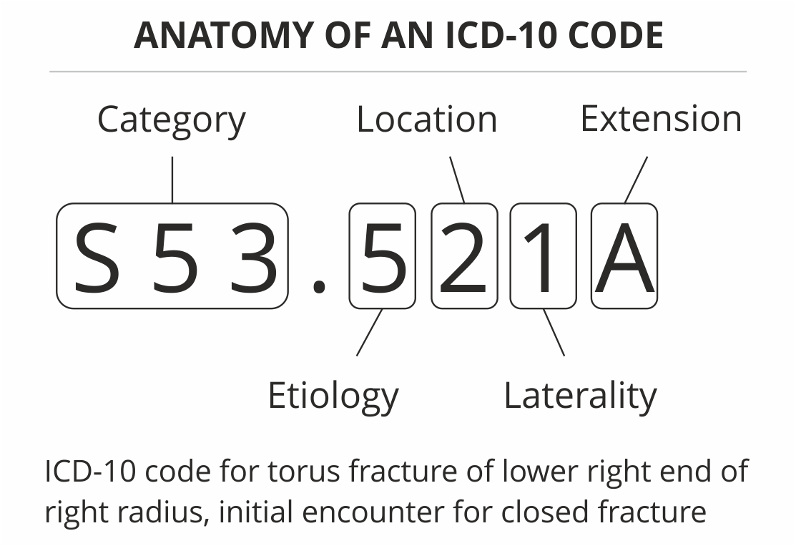
Sample ICD Code
4

Slide 5
ICD-10 Code Hierarchy
5
Level Identifier | Example | Total Labels
Level 1 | A00-B99 Certain infectious and parasitic diseases | 22
Level 2 | A00-A09 Intestinal infectious diseases | 258
Level 3 | A01 Typhoid and paratyphoid fevers | 1911
Exact Code | A00.9 Cholera, unspecified | 69000+

Slide 6
Data Challenges
6
A medical record and its corresponding ICD-10 code vary significantly in its description
Many medical records in the dataset lack comprehensibility
Inconsistency in amount of information present in each record
Handling Negation statements like "no fever"
Large amount of noise in the dataset
Spelling and grammar errors
No consistency in use of abbreviations
Difference in writing styles
Use of special characters like "--->"
High number of possible labels – multiple labels per row

Slide 7
Data Preprocessing
Removing empty lines
Adding full forms of abbreviation

Slide 8
Sample abbreviations and full forms
8
abbreviation | Full form
st | sinus tachycardia/ ST-segement of ecg
icteric | a state of yellowness due to elevated bilirubin
abd | abdomen
abdo | abdomen
apd | acute peptic disease
adv | advice
atd | after test dose
avpu | alert, verbal, pain, unconcious
aloc | altered level of consciousness
abs | amniotic band syndrome
Medical records still had some abbreviations that were not in this list

Slide 9
Data Preprocessing
9
HOPI​ | Removed abbreviations and blank lines​
32YR OLD M ​ C/O--FEVER--SINCE YESTERDAY ​ VOMITING ONE EPISODE WATERY YELLOW​ GENRALIZD BODYACHE ​ BACKACHE ​ FEVER--ON OFF, WITH CHILLS ​ COUGH DRY-YESTERDAY ​ SYSTEMIC REVIEW--> LOWER ABD DISCOMFORT, CONSTIPATIO-RELATIVE--> LAST BOWEL MOVEMENT IN MORNING ​ S/P--> SURGICAL INTERVENTION--FOR BOWEL ISSUES 1097--BOWEL RESECTION AND END TO END REPAIR> NO RECORD AVAILABLE​ O/E-->CHEST CLEAR ABD DOFT NONTENDER--MIDLINE LOWER ABD SCAR GUT SOUNDS NORMAL​ DRE RECTUM EMPTY​ THROAT CLEAR​ TEMP 103​ PLAN--CBC MP MPICT​ XRAY ABD ​ INJ NOSPA IV STT INJ ZANTAC IV STAT INJ GRAVINAT STAT​ labs seen wnl​ patient hemodynamically stable painfree​ dc on oral meds​ FNF​ | 32yr old m. c/o--fever--since yesterday. vomiting one episode watery yellow. genralizd bodyache. backache. fever--on off, with chills. cough dry-yesterday. systemic review--> lower abdomen discomfort, constipatio-relative--> last bowel movement in morning. s/p--> surgical intervention--for bowel issues 1097--bowel resection and end to end repair> no record available. o/e-->chest clear abdomen doft nontender--midline lower abdomen scar gut sounds normal. dre rectum empty. throat clear. temp 103. plan--cbc malarial parasite mpict. xray abd. injection nospa intravenous stt injection zantac intravenous stat injection gravinat stat. labs seen wnl. patient hemodynamically stable painfree. discharge on oral meds. fnf​

Slide 10
Approach 1
10

Slide 11
Sample Record#1: Model Output using HOPI
11
Removed abbreviations and blank lines | ED_DX | Actual Codes | Model Output using HOPI | Model Output using ED_DX
32yr old m. c/o--fever--since yesterday. vomiting one episode watery yellow. genralizd bodyache. backache. fever--on off, with chills. cough dry-yesterday. systemic review--> lower abdomen discomfort, constipatio-relative--> last bowel movement in morning. s/p--> surgical intervention--for bowel issues 1097--bowel resection and end to end repair> no record available. o/e-->chest clear abdomen doft nontender--midline lower abdomen scar gut sounds normal. dre rectum empty. throat clear. temp 103. plan--cbc malarial parasite mpict. xray abd. injection nospa intravenous stt injection zantac intravenous stat injection gravinat stat. labs seen wnl. patient hemodynamically stable painfree. discharge on oral meds. fnf | RTI/ CONSTIPATION | R50.9, R11.10 R52, M54.9, R05.9, K59.00 | "R10.3" # Pain localized to other parts of lower abdomen "R11" # Nausea and vomiting "R68.8"# Other specified general symptoms and signs "M54.99"# Dorsalgia, unspecified "R05" # Cough "K59.0" # Constipation | "K59.0" # Constipation

Slide 12
Sample Record#1 Model Performance
12
Level 3
Actual Codes | Predicted Codes
R50 R11 R52 M54 R05 K59 | R10 R11 R68 M54 R05 K59
Level 2
Actual Codes | Predicted Codes
R50-R69 R10-R19 M50-M54 R00-R09 K55-K64 | R50-R69 R10-R19 M50-M54 R00-R09 K55-K64
Level 1
Actual Codes | Predicted Codes
R00-R99 M00-M99 K00-K95 | R00-R99 M00-M99 K00-K95
S. No. | Experiment Description | Precision | Recall | F-measure
1 | Exact Code Match | 0 | 0 | 0
2 | Level 1 | 1 | 1 | 1
3 | Level 2 | 1 | 1 | 1
4 | Level 3 | 0.67 | 0.67 | 0.67

Slide 13
Sample Record#2
13
Hopi | Ed_dx
28YR OLD M NKCM | PRESENTS IN ER WITH THE HX OF TRAUMA | MECHANISM->GOT BEATEN BY PUBLIC AFTER HE STOLE SOMETHING | BROUGHT TO ER BY POLICEMEN | === | ON ARRIVAL IN ER | AIRWAY - CLEAR | BREATHING NORMAL | CIRCULATION BP 157/80 | DISABILITY- GCS 15/15 PUPIL BERL | EXPOSURE-> TENDER NESS AND CREPITUS OVER RT SHOULDER | ALSO RT WRIST TENDER , MULTIPLE LACERATIONS OVER FACE, RT PERIORBITAL EDEMA | CHEST CLEAR | ABD SOFT NT | SPINE UNREMAKABLE | DRE UNREMARKABLE | CERVICAL PAIN-> CERVICAL COLLAR APPLIED. | === | BED SIDE US FAST DONE-- NEGATIVE | CXR UNREMARKABLE | RT NECK OF HUMERUS FRACTURE + | === | INJ NS 1 LIT IV BOLUS STAT INJ ATS IM STAT INJ TORADOL 30MG IV STAT , APPLY POLYSLING TO RT SHOULDER. | == | orthopedics | x-ray-- right shoulder light bulb sign with bankart lesion | right neck of humerus fracture | plan | apply polysling | need sopen reduction | beds not avAILABLE. | refer to other tertiary care setup. | also needs evaluation by MLO for mlc | === | refer out as no beds and also no MLO available at tih | | trauma/assault/right shoulder light bulb sign with bankart lesion

Slide 14
Sample Record#2 Model Performance
14
Level 3
Actual Codes | Predicted Codes
Y09 S01 H05 S42 | Y09 T01 R19 S49 M54 S42 R60 T14 A35
Level 2
Actual Codes | Predicted Codes
X92-Y09 S00-S09 H00-H05 S40-S49 | T14-T14 R50-R69 R10-R19 M50-M54 A30-A49 S40-S49
Level 1
Actual Codes | Predicted Codes
V00-Y99 S00-T88 H00-H59 | R00-R99 S00-T88 M00-M99 A00-B99
S. No. | Experiment Description | Precision | Recall | F-measure
1 | Exact Code Match | 0 | 0 | 0
2 | Level 1 | 0.33 | 0.25 | 0.286
3 | Level 2 | 0.25 | 0.17 | 0.2
4 | Level 3 | 0.5 | 0.2 | 0.3

Slide 15
Sample Record#3
15
Hopi | Ed_dx
20 Year old male | nkcm , denies addiction | works at a garment factory | came in ED, with CO- | pain in suprapubic region , since last night, aggravated since moring, hx of passage of stones ( about 2 stones) yesterday, since then he has difficulty in passing urine, associated with dribbling of urine, | he had hx of renal stones 6 months for which he took homeopathic meds and was relieved. | no complains of heamaturia, pyuria, | no hx of fever, vomiting, flank pain | OE: | young male, with normal built and height | consious , alert , GCS 15/15 | abdomen - distended , bladder palpable till umbilicus , | perinuem - unremarkable | plan: | vitals | inj diclo i/m stat | inj nospa iv stat | send urine dr, cs | x-ray kub ( penile view) | pass folleys ( stat output- 600ml - 1500ml) | consult to urology oncall - dr mubeen @ 12.30pm, will follow. | Cap. Maxflow 0.4MG - 0+0+1 - Continue | Tab. Voren 50MG - 1+0+1 - 3 days then as per need | Tab. Nuberol Forte 1+1+1 - 3days then as per need | fu in opd as scheduled" | ​ | AUR+ BOO ?

Slide 16
Sample Record#3 Model Performance
16
Level 3
Actual Codes | Predicted Codes
R10 R30 N39 | R10 R22 N39 R11 R39 R31
Level 2
Actual Codes | Predicted Codes
R10-R19 R30-R39 N30-N39 | R10-R19 R30-R39 N30-N39 R20-R23
Level 1
Actual Codes | Predicted Codes
R00-R99 N00-N99 | R00-R99 N00-N99
S. No. | Experiment Description | Precision | Recall | F-measure
1 | Exact Code Match | 0 | 0 | 0
2 | Level 1 | 1 | 1 | 1
3 | Level 2 | 1 | 0.75 | 0.857
4 | Level 3 | 0.67 | 0.33 | 0.44

Slide 17
Approach 2 – Top N Similar Records
17

Slide 18
Sample Record # 1
18
Removed abbreviations and blank lines | ED_DX
32yr old m. c/o--fever--since yesterday. vomiting one episode watery yellow. genralizd bodyache. backache. fever--on off, with chills. cough dry-yesterday. systemic review--> lower abdomen discomfort, constipatio-relative--> last bowel movement in morning. s/p--> surgical intervention--for bowel issues 1097--bowel resection and end to end repair> no record available. o/e-->chest clear abdomen doft nontender--midline lower abdomen scar gut sounds normal. dre rectum empty. throat clear. temp 103. plan--cbc malarial parasite mpict. xray abd. injection nospa intravenous stt injection zantac intravenous stat injection gravinat stat. labs seen wnl. patient hemodynamically stable painfree. discharge on oral meds. fnf | RTI/ CONSTIPATION

Slide 19
Sample Record#1 Model Performance
19
Level 3
Actual Codes | Predicted Codes
R50 R11 R52 M54 R05 K59 | A78 (0.22) Y90 (0.22) R05 (0.23) A75 (0.24) D72 (0.24) R07 (0.24)
Level 2
Actual Codes | Predicted Codes
R50-R69 R10-R19 R50-R69 M50-M54 R00-R09 K55-K64 | R00-R09 (0.24) R10-R19 (0.24) D70-D77 (0.25) R70-R79 (0.25) A75-A79 (0.25) Y62-Y69 (0.25)
Level 1
Actual Codes | Predicted Codes
R00-R99 M00-M99 K00-K95 | R00-R99(0.232) E00-E89 (0.248) U00-U85 (0.258) K00-K95 (0.265)
S. No. | Experiment Description | Precision | Recall | F-measure
1 | Exact Code Match | - | - | -
2 | Level 1 | 0.5 | 0.66 | 0.571
3 | Level 2 | 0.334 | 0.4 | 0.364
4 | Level 3 | 0.166 | 0.166 | 0.166

Slide 20
Sample Record # 2
20
Hopi | Ed_dx
28YR OLD M NKCM | PRESENTS IN ER WITH THE HX OF TRAUMA | MECHANISM->GOT BEATEN BY PUBLIC AFTER HE STOLE SOMETHING | BROUGHT TO ER BY POLICEMEN | === | ON ARRIVAL IN ER | AIRWAY - CLEAR | BREATHING NORMAL | CIRCULATION BP 157/80 | DISABILITY- GCS 15/15 PUPIL BERL | EXPOSURE-> TENDER NESS AND CREPITUS OVER RT SHOULDER | ALSO RT WRIST TENDER , MULTIPLE LACERATIONS OVER FACE, RT PERIORBITAL EDEMA | CHEST CLEAR | ABD SOFT NT | SPINE UNREMAKABLE | DRE UNREMARKABLE | CERVICAL PAIN-> CERVICAL COLLAR APPLIED. | === | BED SIDE US FAST DONE-- NEGATIVE | CXR UNREMARKABLE | RT NECK OF HUMERUS FRACTURE + | === | INJ NS 1 LIT IV BOLUS STAT INJ ATS IM STAT INJ TORADOL 30MG IV STAT , APPLY POLYSLING TO RT SHOULDER. | == | orthopedics | x-ray-- right shoulder light bulb sign with bankart lesion | right neck of humerus fracture | plan | apply polysling | need sopen reduction | beds not avAILABLE. | refer to other tertiary care setup. | also needs evaluation by MLO for mlc | === | refer out as no beds and also no MLO available at tih | | | trauma/assault/right shoulder light bulb sign with bankart lesion

Slide 21
Sample Record#2 Model Performance
21
Level 3
Actual Codes | Predicted Codes
Y09 S01 H05 S42 | R40 (0.29) R10 (0.3) M12 (0.31) M02 (0.31) S45 (0.31) S41 (0.31)
Level 2
Actual Codes | Predicted Codes
X92-Y09, S00-S09, H00-H05, S40-S49 | R10-R19 (0.3) R40-R46 (0.3) M70-M79 (0.31) S40-S49 (0.32) M86-M90 (0.32) M91-M94 (0.32)
Level 1
Actual Codes | Predicted Codes
V00-Y99 S00-T88 H00-H59 | M00-M99 (0.31) R00-R99 (0.31) H00-H59 (0.33) S00-T88 (0.33)
S. No. | Experiment Description | Precision | Recall | F-measure
1 | Exact Code Match | - | - | -
2 | Level 1 | 0.5 | 0.667 | 0.571
3 | Level 2 | 0.167 | 0.25 | 0.2
4 | Level 3 | 0 | 0 | 0

Slide 22
Sample Record # 3
22
Hopi | Ed_dx
20 Year old male | nkcm , denies addiction | works at a garment factory | came in ED, with CO- | pain in suprapubic region , since last night, aggravated since moring, hx of passage of stones ( about 2 stones) yesterday, since then he has difficulty in passing urine, associated with dribbling of urine, | he had hx of renal stones 6 months for which he took homeopathic meds and was relieved. | no complains of heamaturia, pyuria, | no hx of fever, vomiting, flank pain | OE: | young male, with normal built and height | consious , alert , GCS 15/15 | abdomen - distended , bladder palpable till umbilicus , | perinuem - unremarkable | plan: | vitals | inj diclo i/m stat | inj nospa iv stat | send urine dr, cs | x-ray kub ( penile view) | pass folleys ( stat output- 600ml - 1500ml) | consult to urology oncall - dr mubeen @ 12.30pm, will follow. | Cap. Maxflow 0.4MG - 0+0+1 - Continue | Tab. Voren 50MG - 1+0+1 - 3 days then as per need | Tab. Nuberol Forte 1+1+1 - 3days then as per need | fu in opd as scheduled" | ​ | AUR+ BOO ?

Slide 23
Sample Record#3 Model Performance
23
Level 3
Actual Codes | Predicted Codes
R10 R30 N39 | N27 (0.41) N32 (0.42) Q63 (0.42) Q64 (0.42) N28 (0.42) N31 (0.43)
Level 2
Actual Codes | Predicted Codes
R10-R19 R30-R39 N30-N39 | N25-N29 (0.41) N17-N19 (0.41) Q60-Q64 (0.42) R30-R39 (0.44) I10-I16 (0.44) N20-N23 (0.44)
Level 1
Actual Codes | Predicted Codes
R00-R99 N00-N99 | N00-N99 (0.48) R00-R99 (0.49) K00-K95 (0.52) H60-H95 (0.52)
S. No. | Experiment Description | Precision | Recall | F-measure
1 | Exact Code Match | - | - | -
2 | Level 1 | 0.5 | 1 | 0.667
3 | Level 2 | 0.166 | 0.33 | 0.22
4 | Level 3 | 0 | 0 | 0

Slide 24
Summary
24

Slide 25
Summarized Results (for 200 records)
25
Approach 1
S. No. | Experiment Description | Precision | Recall | F-measure
1 | Exact Code Match | 0 | 0 | 0
2 | Level 1 | 0.50 | 0.63 | 0.53
3 | Level 2 | 0.41 | 0.47 | 0.40
4 | Level 3 | 0.36 | 0.33 | 0.32
Approach 2
S. No. | Experiment Description | Precision | Recall | F-measure | Suggested Labels Count
1 | Exact Code Match | - | - | - | -
2 | Level 1 | 0.358 | 0.604 | 0.425 | 4
3 | Level 2 | 0.176 | 0.348 | 0.22 | 6
4 | Level 3 | 0.074 | 0.133 | 0.089 | 6

Slide 26
Conclusion
This is an early-stage model and could be improved further.
Level-1 achieves highest F-score of 0.53 so far.
Some extra ICD-10 codes returned from the model needs validation as human annotator might have missed some codes while labelling due to human error.
Need feedback if output from model would be useful to Indus? What will be the utility?

